Slide 1
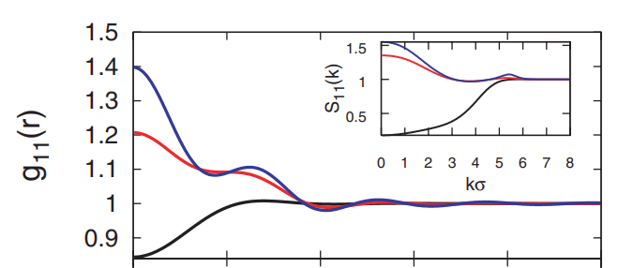
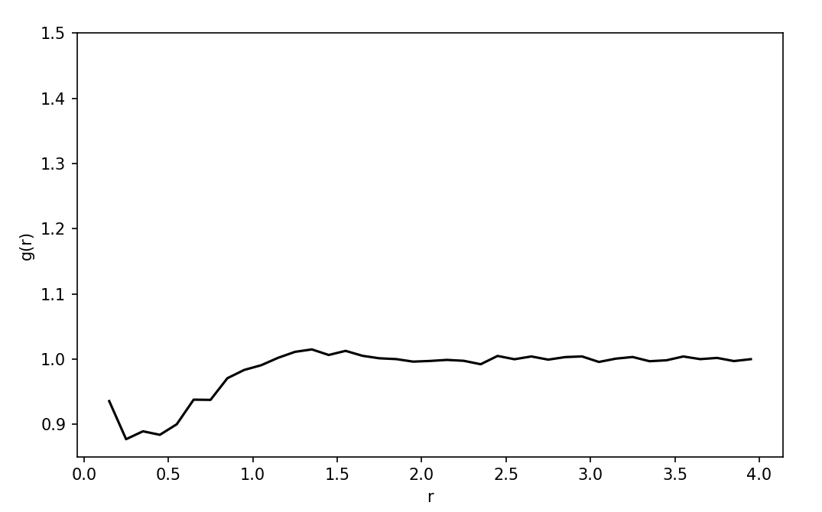
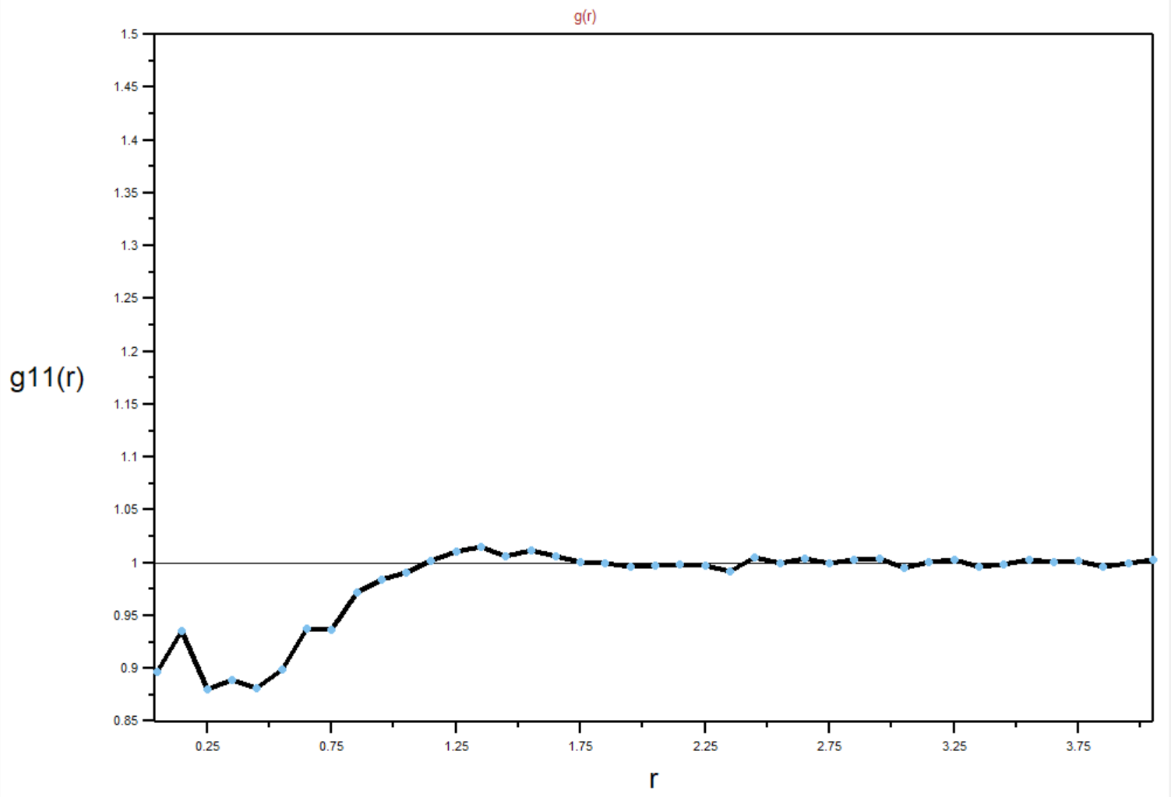
Preliminary Results: g₁₁(r) at x = 0.1 & ρ = 5.5
DFT: Likos et. al
MD: VMD g(r) toolbox
MD: LAMMPs g(r) function
0.0
2.0
4.0
Z/σ
Z/σ
Z/σ
Goal: generate the black curve
Observation: Number of bins for g(r) should be < 0.1*max(Z/σ). To many bins can lead to noise.

